Slide 1
Year 10 Revision Engagement Evening
16th April 2026
Why do we do trial exams?

Slide 2


Trial Examinations – what do they mean?

Slide 3

Trials aren’t just about the first box
Practice under real conditions
A progress checkpoint – show where you are now
Building confidence
Ways for teachers to gather evidence to see if you need further support
Opportunity to sharpen your skills – apply revision strategies, memory techniques and exam skills
Trial outcomes do inform student class groupings.
They also influence the tier of the exam you will be entered for.
A safe space to fail – better now than in the summer!

Slide 4
Start date: WC 01/06/2026
End date: 19/06/2026
Trial Examinations
  All exams to take place in the sports hall unless stated on the timetable.
  Students must attend form time first.
  Students to go to the yard 8:45am following AM registration.
  Students must line up in their form areas and in alphabetical order.
  Morning session start time 9:00am prompt.
  All exams will finish for the end of the school day at 15:10pm, students will return to lessons, if an exams finishes before 15:10pm.

Slide 5
Get Exam Ready
Over the next 3 weeks during form time, will be providing tips and techniques to help you to prepare for your trial exams in June.

Slide 6

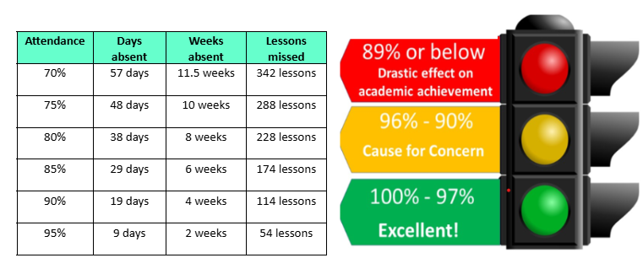
FACT- Students with 95% attendance or above achieve, on average, one grade higher in their GCSEs.
Even missing the equivalent of one week per term can reduce performance by half a grade.

Slide 7
Revision Techniques - Getting Prepared

Slide 8
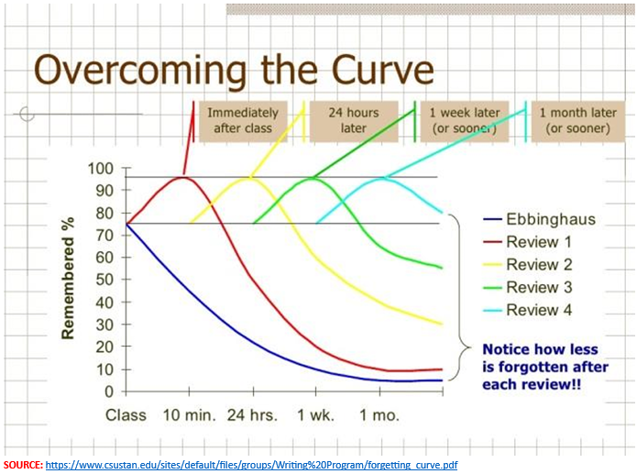
Getting Prepared
This is why cramming doesn’t work!
It is proven that by reviewing what you’ve learnt in regular intervals, you can reduce how much you forget to just 10%.

Slide 9

Starting Early…
The most important part of preparation is starting your revision early.
Some of you may have already started revising, some of you may not have started at all.
You might be thinking:
I don’t even know how to revise or where to start
I have plenty of time, I still have 9 months until my exams…
I will be able to just cram it all in the night before each exam
These are all normal feelings towards exams, particularly at this time of year.
However, it is important to start planning your revision whilst you still have enough time.
I don’t like some subjects so I’m not going to bother revising
None of my friends are revising, so why should I?
Session 1: Getting prepared

Slide 10
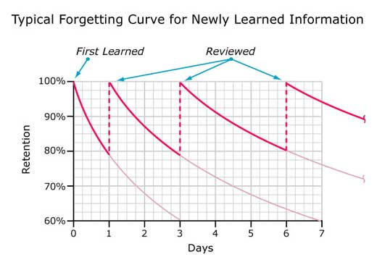
Revision Planning
Memory
Psychological research suggests that:
When we learn something, we rapidly forget much of it.
When we re-visit something we’ve learned repeatedly, we remember it better.
Effective revision of the knowledge and skills covered in lessons is, therefore, crucial to exam success.

Slide 11
Advantages of Revision
Memory Enhancement
Builds Confidence
Relieves Exam Stress
Increases Speed of Writing
Decreases Exam Phobia - Repeated revision ensures that you will not go blank during exam.
Different revision techniques have different advantages.

Slide 12
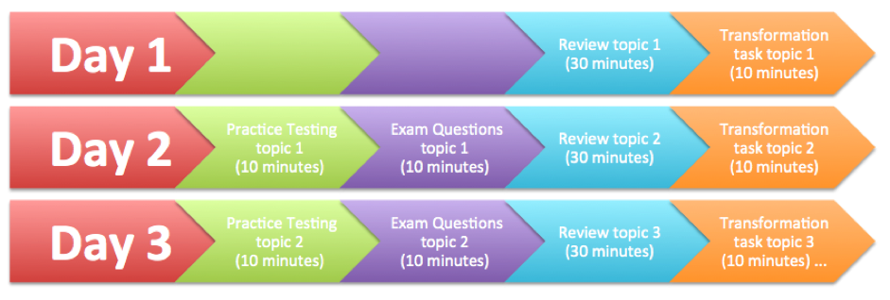
Revision Planning
Distributed Practice [Practice over Time]
Vs.
Mass Practice [Cramming]
Cramming the week or night before an exam is not effective
Which revision strategies work best?
Regular revision sessions, spaced out over a long period of time, are the most successful.
The more detailed or complex the information you are trying to remember, the longer the period needed.
It does not matter which of the revision techniques are used - distributed practice works well for them all.

Slide 13
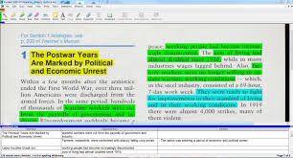

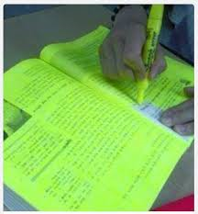
Revision Planning
Interleaved Practice [Revising several topics in chunks]
Vs.
Block Practice[Revising one topic at a time]
There are a range of techniques students can use when revising – some are effective and others less so.
Techniques to avoid:
Highlighting text
Re-reading notes
Summarising
These are not effective because:
Challenge is low
Little thinking is required
Gives a false sense of achievement

Slide 14
Revision Planning –
Most effective techniques
The most effective techniques students can use to aid their revision are:
Flashcards
Mnemonics
Interrogation [asking why?]
Mind Maps
[Preview, Question, Read, Say, Test]
Past Papers
Study buddy

Slide 15
Frequency of revision
Revision must be done as many times as you study.
It means that revision must follow every time you study.
Revision must be done every day.
Before you start your studies today, revise what you studied yesterday using the brief notes you had made.
At the end of the week, revise the whole week’s studies.

Slide 16
Starting Early… What can I be doing?
Gather your exam timetable & syllabus content.
Identify topics you’re confident in vs. areas to improve.
Set long-term goals (e.g., “secure grade 7 in maths”).
Start revision early – last minute cramming never works!
Create a revision timetable
Session 1: Getting prepared

Slide 17
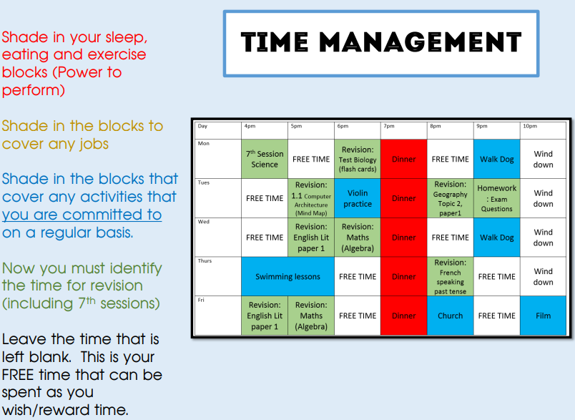


Slide 18
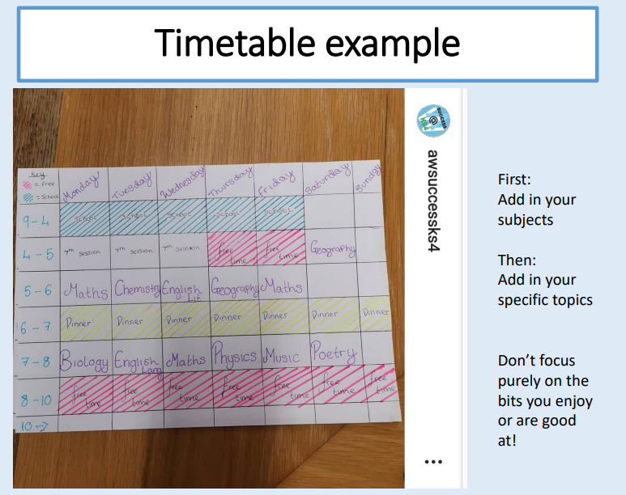

Slide 19
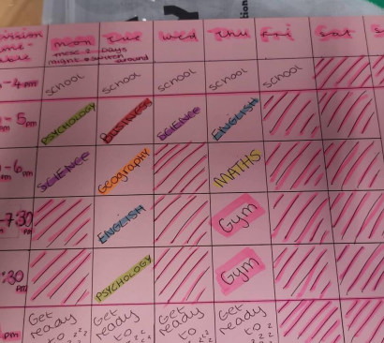
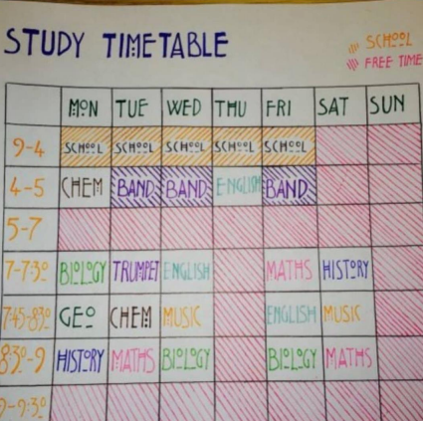
More examples

Slide 20
Science
Mr K Lysaght
Head of Science

Slide 21
Trial Examination Information
Triple Science
1 x Biology Paper 1 (1hr 45min)
1 x Chemistry Paper 1 (1hr 45min)
1 x Physics Paper 1 (1hr 45min)
Graded separately – 3 grades overall.
Combined Science
1 x Biology Paper 1 (1hr 15min)
1 x Chemistry Paper 1 (1hr 15min)
1 x Physics Paper 1 (1hr 15min)
Combined double grade e.g. 4,4 or 5,4

Slide 22
Higher Tier – Triple
Standard and High demand questions only.
Grades 9 – 4
Must be working at a solid grade 5.
Foundation Tier – Triple
Low and Standard questions only.
Grades 5 – 1

Slide 23
Higher Tier – Combined
Standard and High demand questions only.
Grades 9,9 – 4,3
Must be working at a solid 5,5
Foundation Tier – Combined
Low and Standard questions only.
Grades 5,5 – 1,1

Slide 24
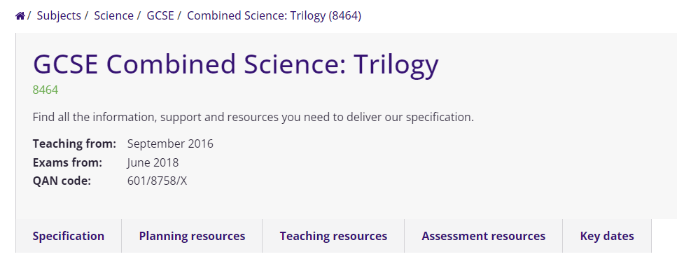
Exam Board Information & Specification
AQA GCSE Combined Science Trilogy (8464)
OR
AQA GCSE Biology (8461)
AQA GCSE Chemistry (8462)
AQA GCSE Physics (8463)

Slide 25
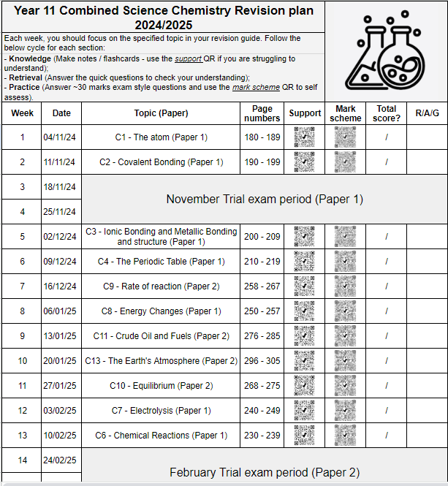

Slide 26
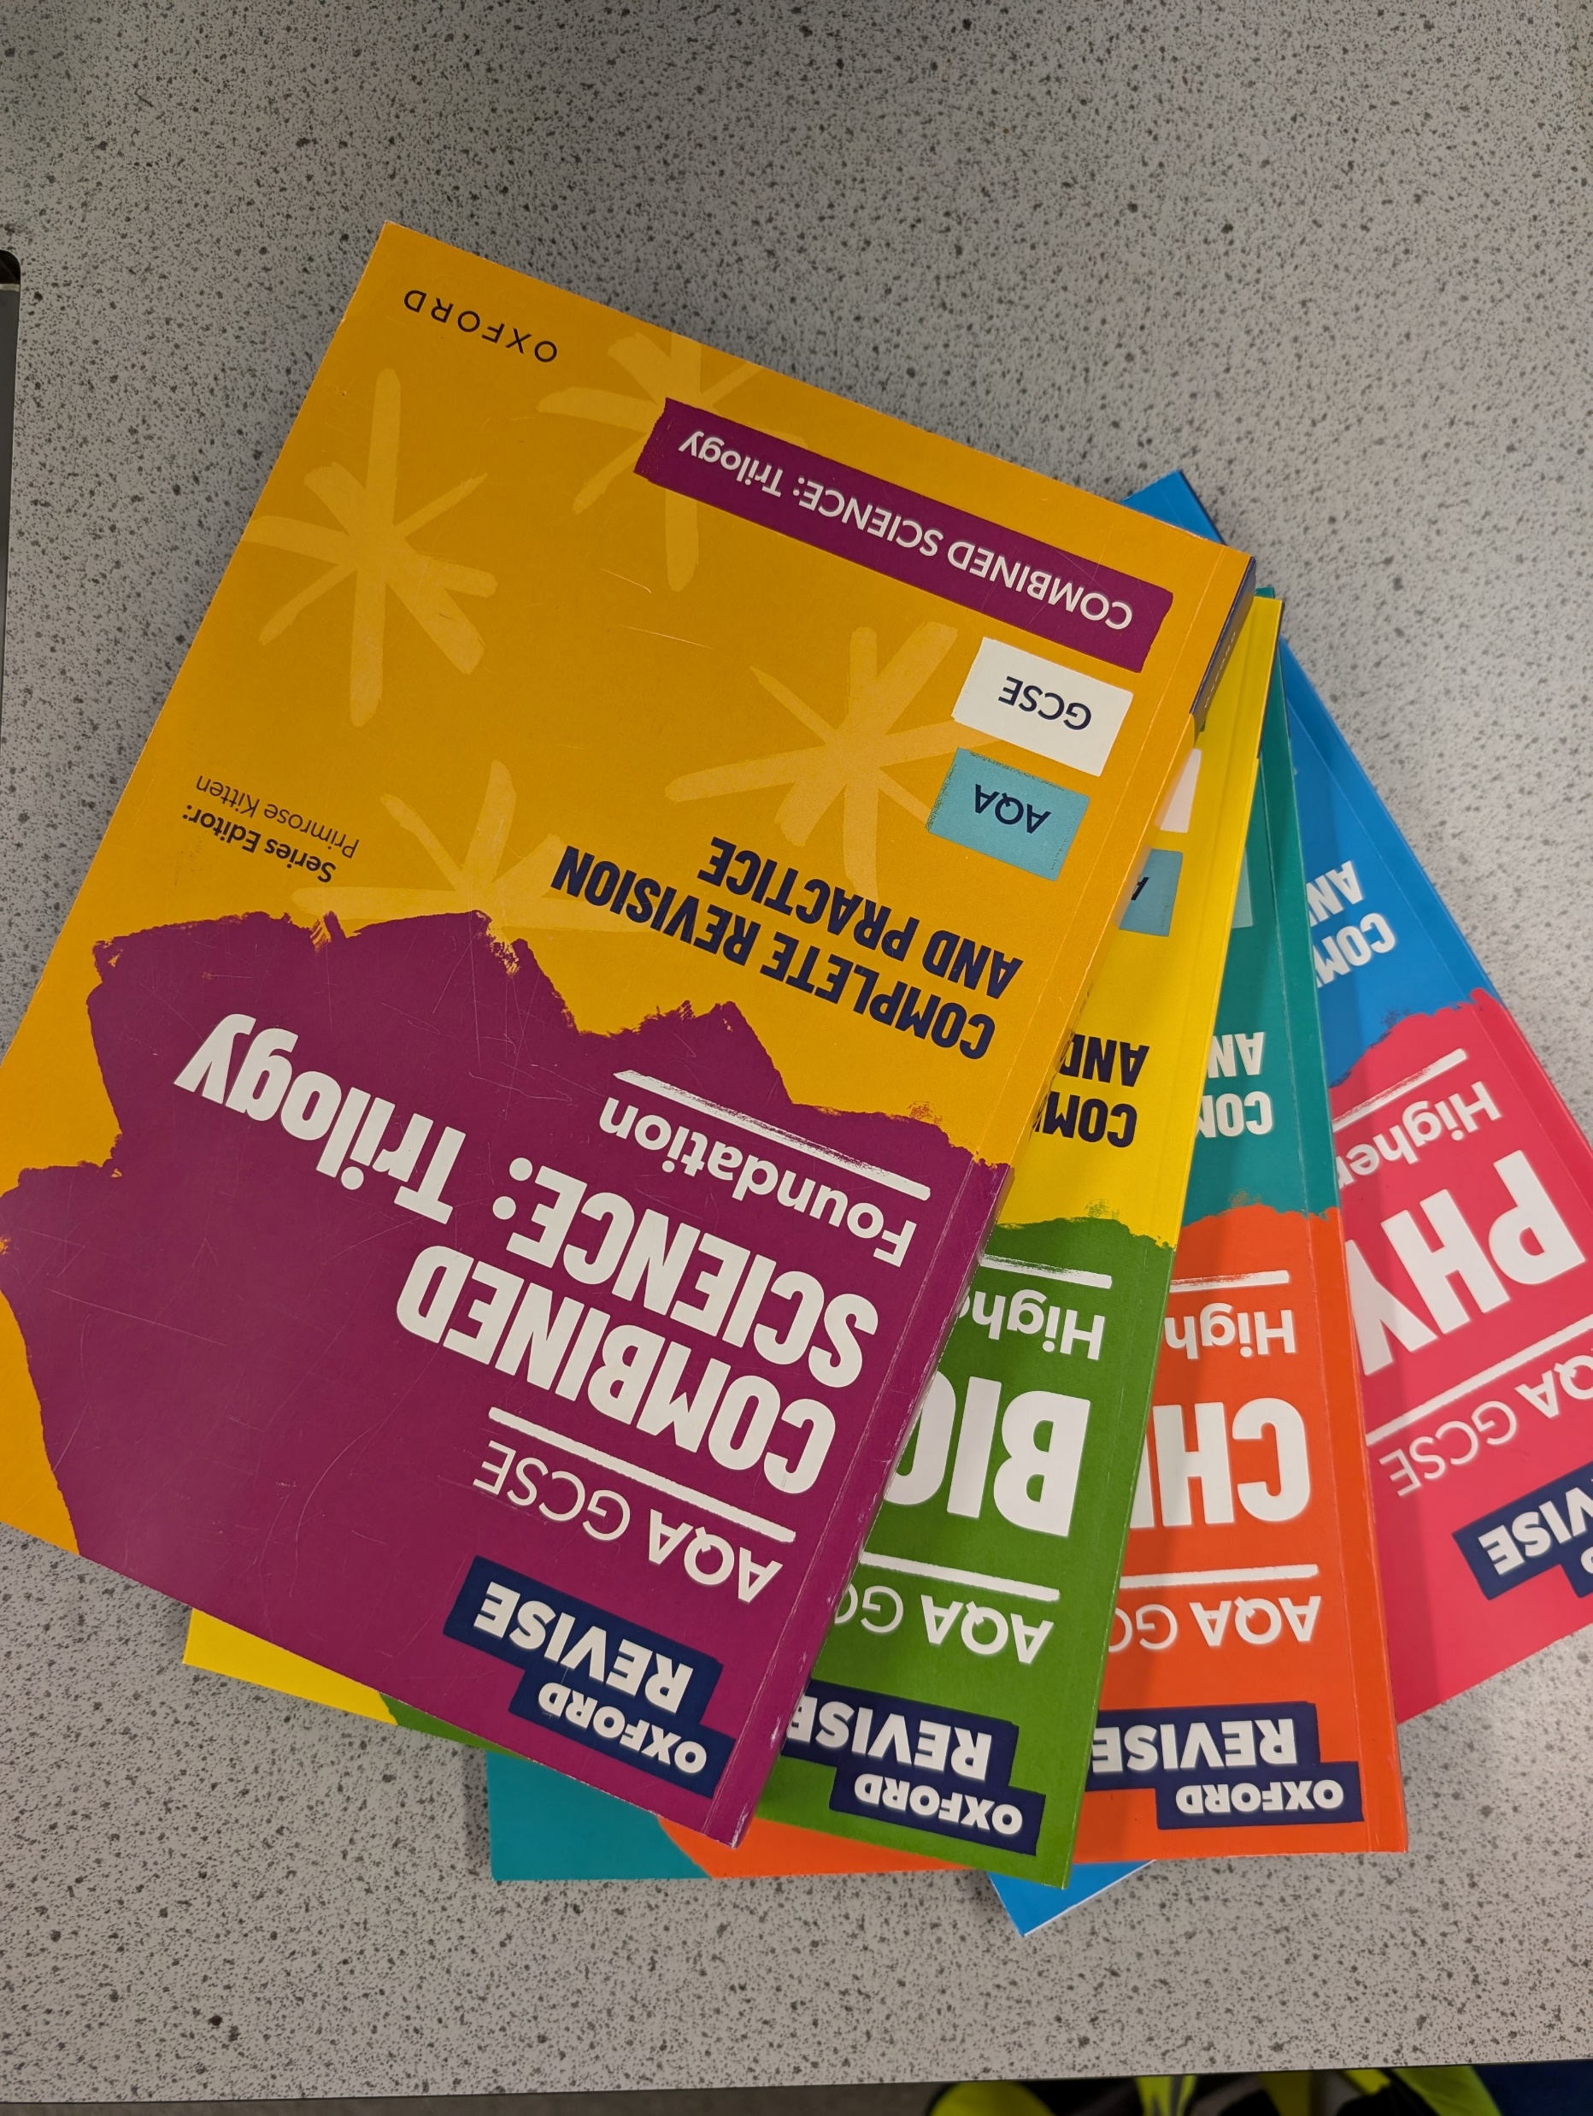
Revising for Science…
You will soon be able to purchase a GCSE Science revision guide through us through Arbor.

Slide 27
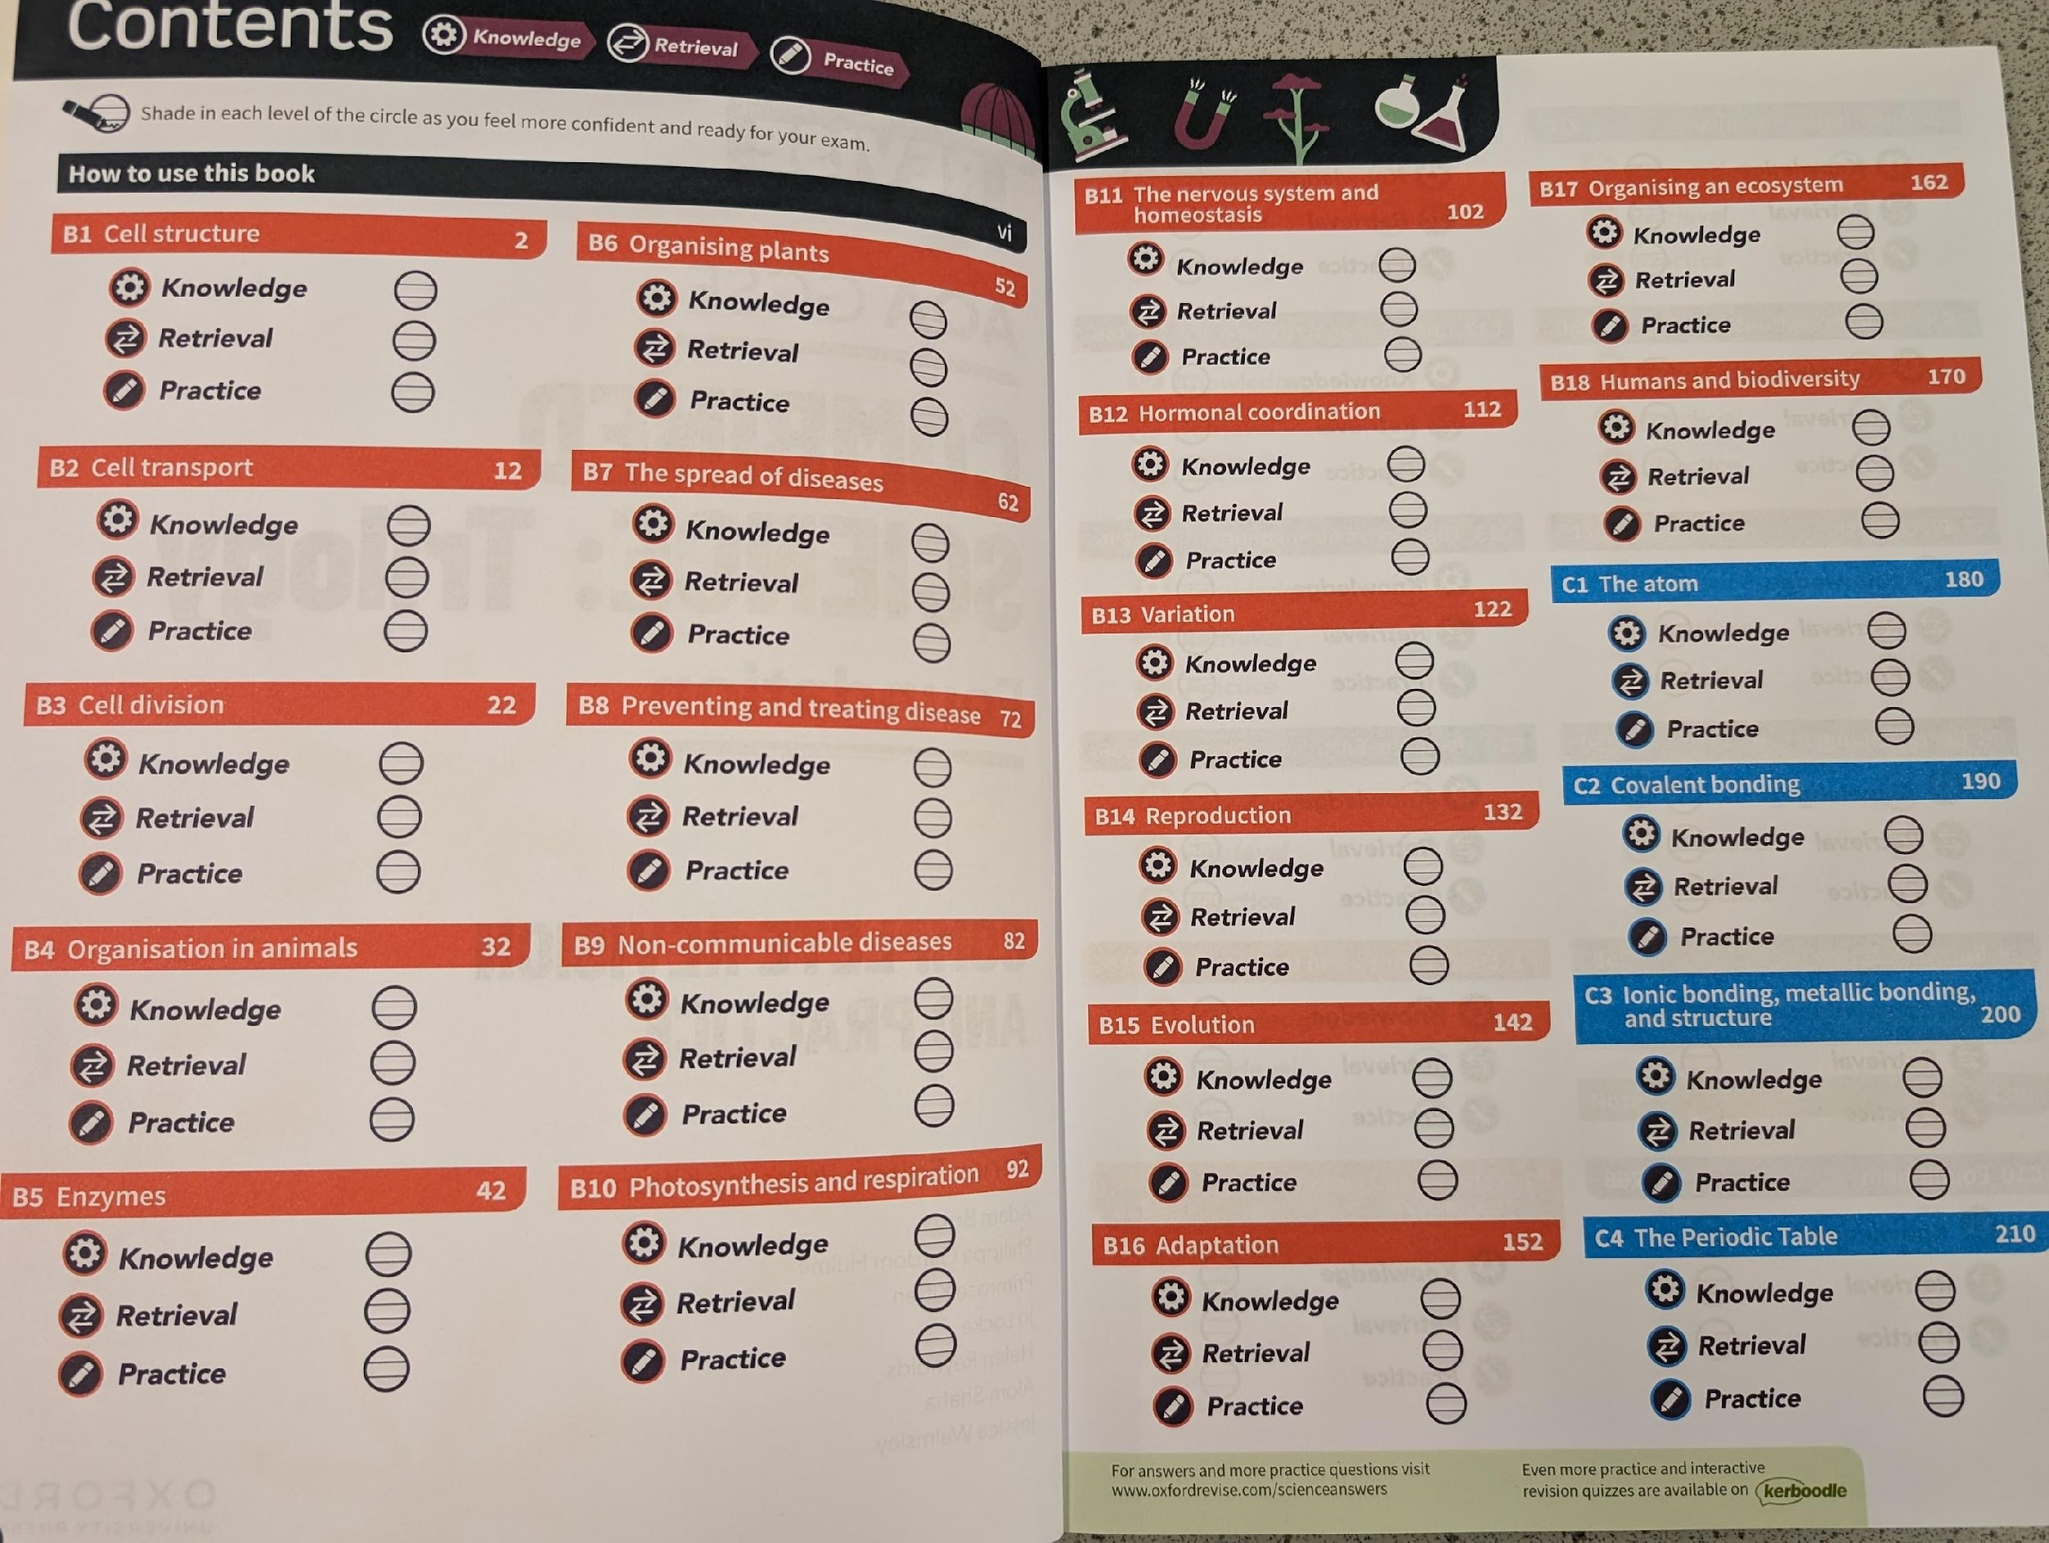
How do I know what to revise?

Slide 28
How do I revise?
KNOWLEDGE!
RETRIEVAL!
PRACTICE!

Slide 29
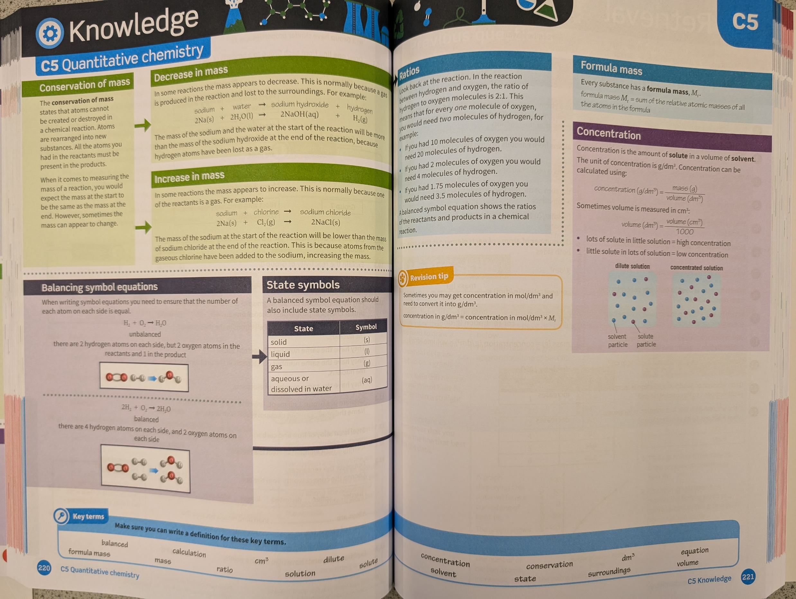
KNOWLEDGE!
Make revision cards;
Do a mindmap summary;
Use a highlighter;
Use post-it notes.
Try to summarise and review your knowledge!

Slide 30
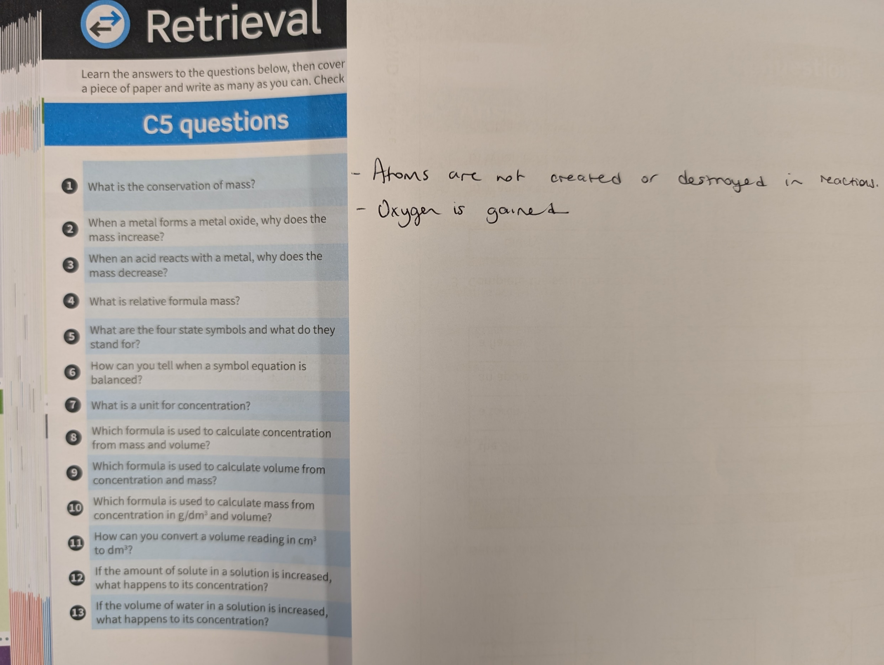
RETRIEVAL!
Quick check questions to ensure you have understood and recall the knowledge for that unit.
Highlight the questions you got incorrect and after a short break, just go back over those before moving on.

Slide 31
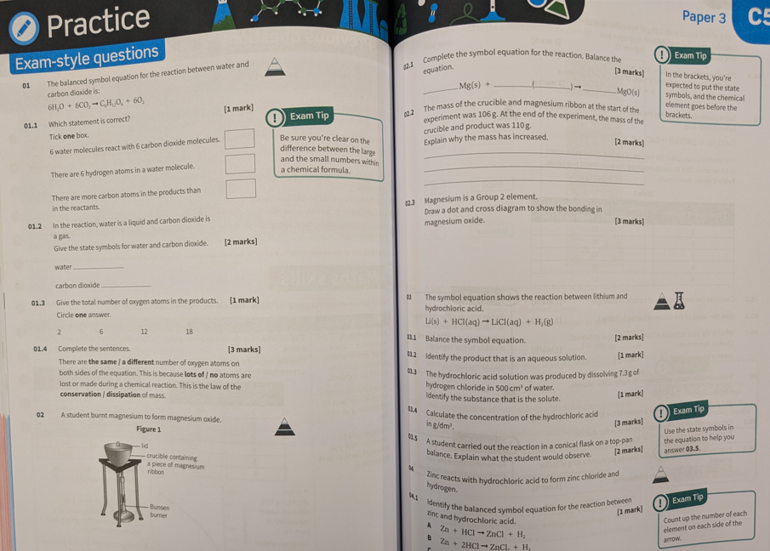
PRACTICE!
Exam style questions!!
See if you are able to apply your knowledge to exam questions.
Use the tips in the margin to help!

Slide 32
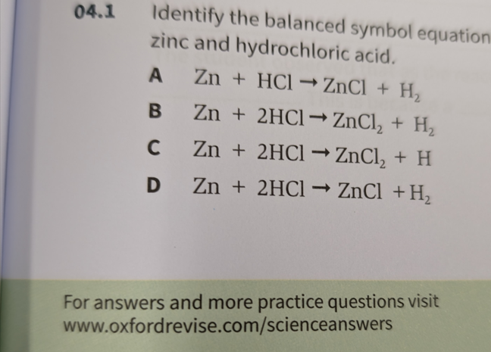
PRACTICE! - Assess

Slide 33
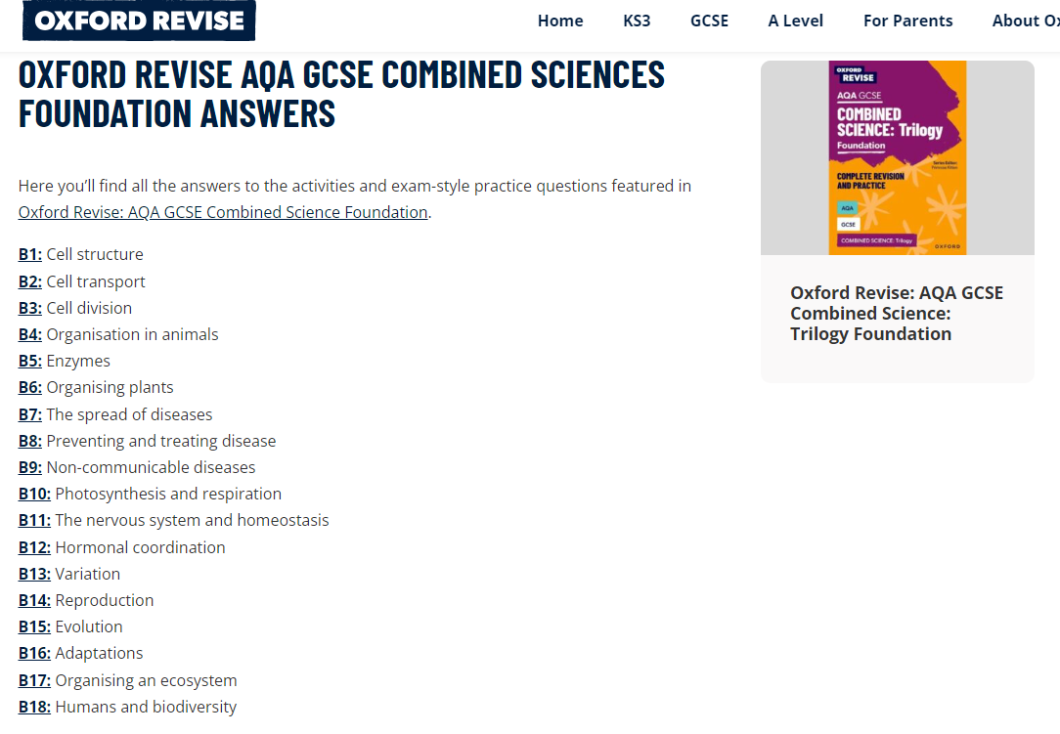
PRACTICE! - Assess

Slide 34
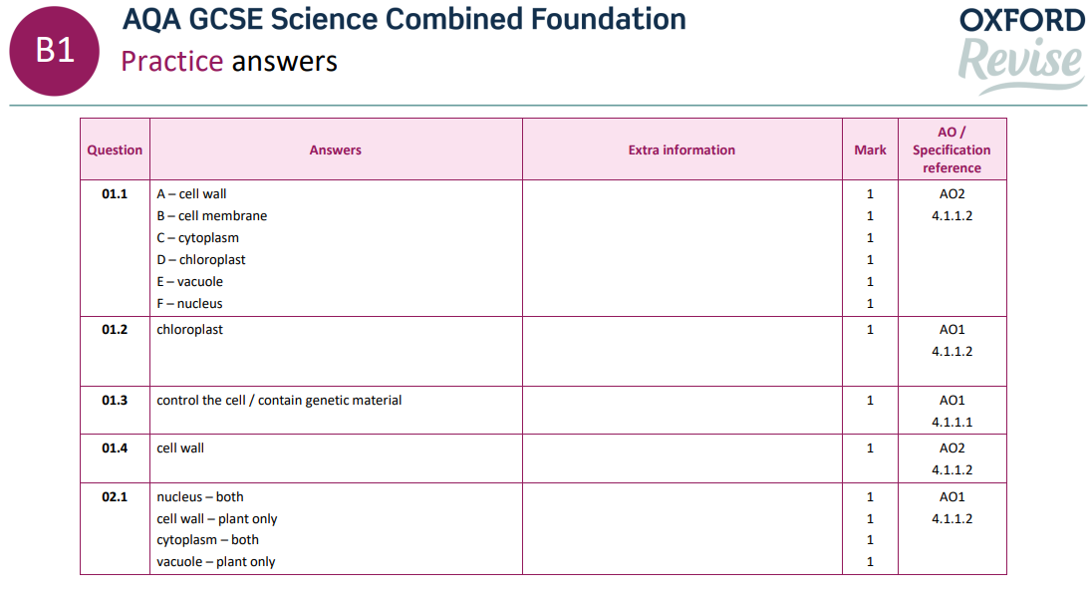
PRACTICE! - Assess

Slide 35
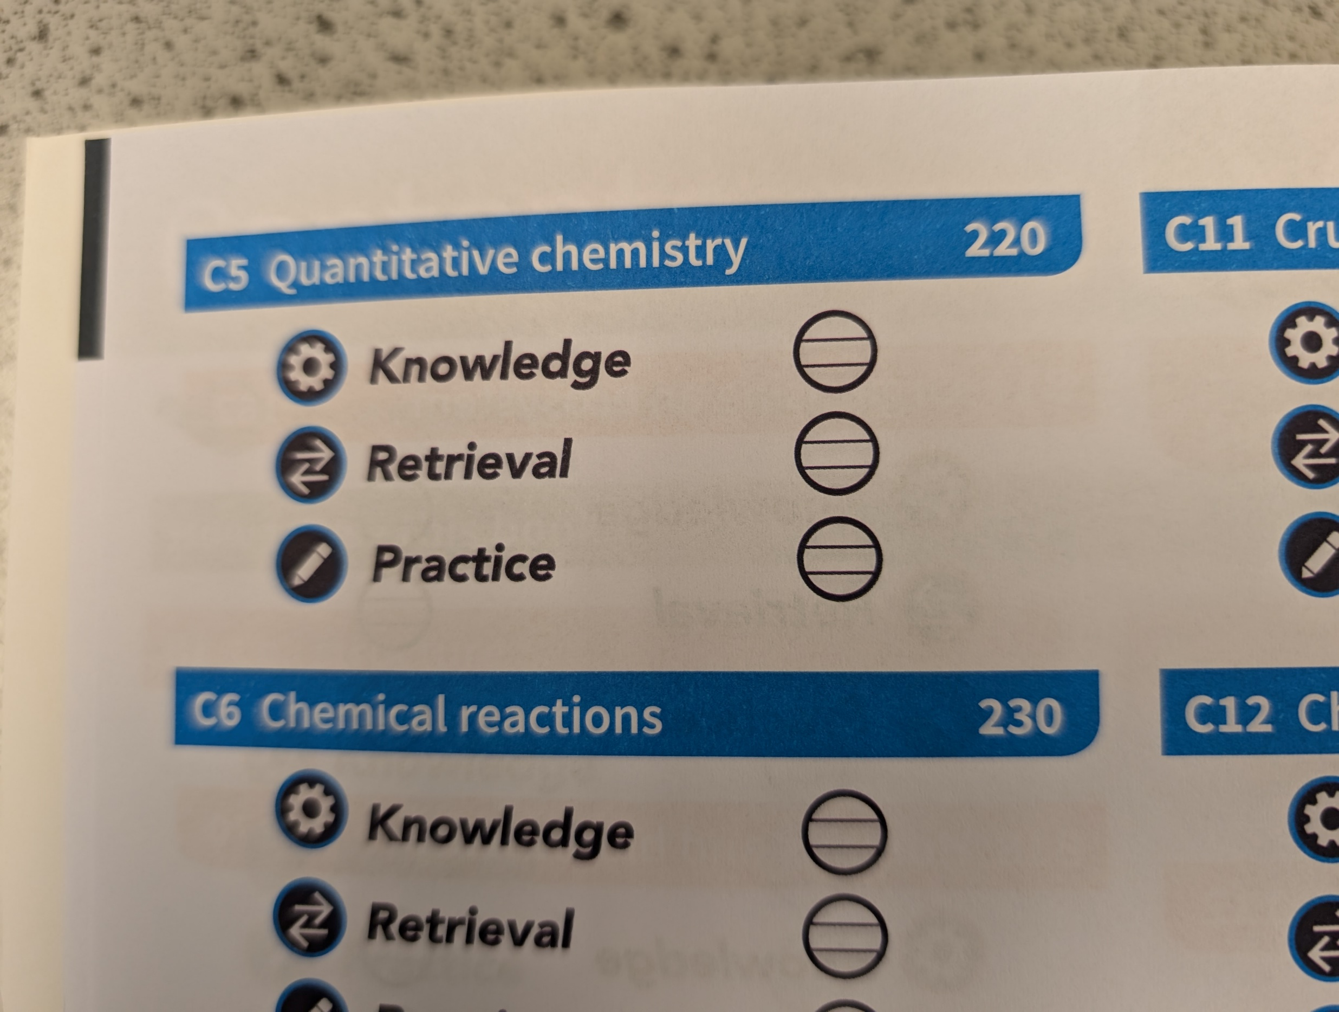
Review and repeat

Slide 36
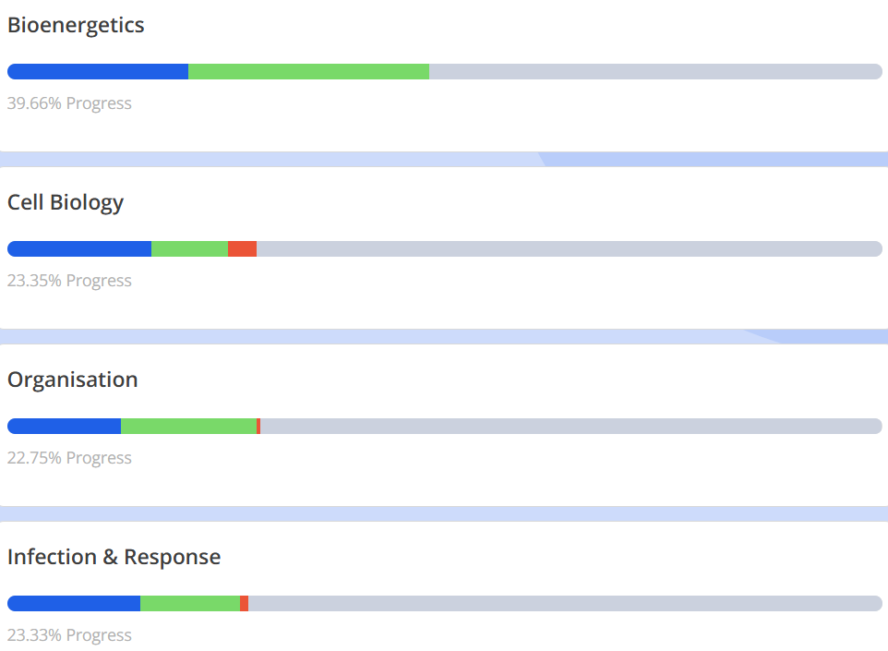
Tassomai

Slide 37
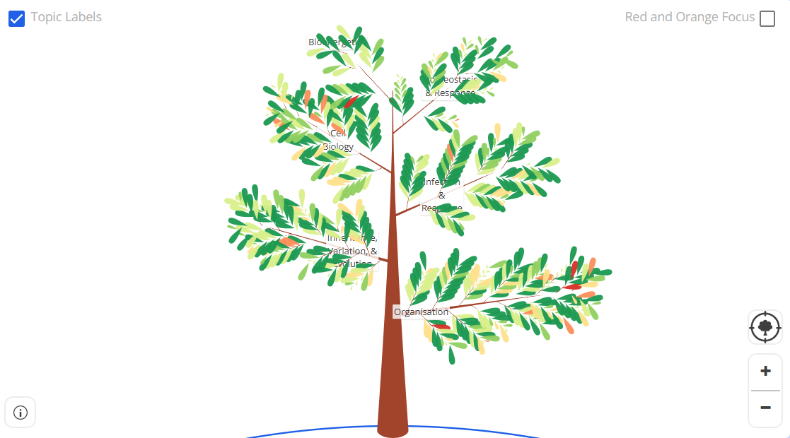
Tassomai

Slide 38
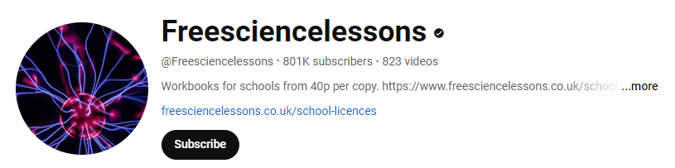
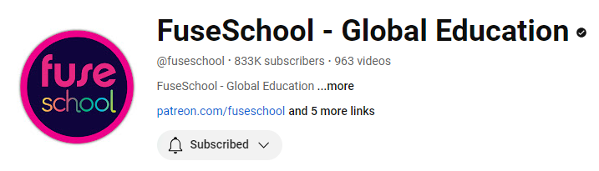
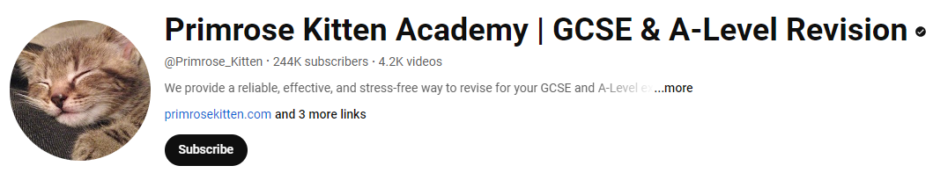
Other methods
Youtube
Bitesize
Past papers
Teachers!!

Slide 39

English
Miss Stanley

Slide 40
What exam board do we use for the English qualification at SJP?
WJEC Eduqas

Slide 41
How many English papers are issued to assess your child’s knowledge in English?
Your child will receive a qualification in English Literature and Language. Therefore the assessment for each qualification consists of two externally-examined papers. Students must complete all four papers in order to achieve their qualification in English Language and Literature.

Slide 42
Assessment is 100% exam
Paper 1 Macbeth and Poetry Anthology
Total 80 marks (40%)
-2 hours long
English Literature
Paper 2 An Inspector Calls, A Christmas Carol and Unseen Poetry
Total 120 marks (60%)
2 ½ hours long
Paper 1 Fiction reading and Narrative writing
Total 80 marks (40%)
1 hour 45 minutes long
English Language
Paper 2 Non Fiction reading and Transactional writing
Total 80 marks (60%)
2 hours long

Slide 43
Trial Examination Information - English
Literature - Component 2 Literature (A Christmas Carol, An Inspector Calls and Unseen Poetry).
They will be assessed their understanding of ‘A Christmas Carol’ and ‘An Inspector Calls’ through an extract expand essay question and their knowledge of the unseen poetry through a single poem analysis and comparison question.
Language - Component 2 Language (19th and 21st Century Non-Fiction Reading and Transaction/Persuasive Writing
They will be assessed on six comprehension reading skills questions and will have to complete two non-fiction transactional writing tasks (Letters, articles, reviews, reports, speeches or guides)

Slide 44
Exam Technique - English Literature
To avoid/reduce missing out on crucial marks, students should be encouraged to:
Ensure they have read the front page of the exam paper carefully and answer the correct question. (Remember not all schools do Macbeth, A Christmas Carol and An Inspector Calls, so they must answer the correct questions). Unfortunately too many students made this mistake in the most recent trial exams.
Your child must be able to show the examiner within their answers, the following: “Do they know the text?” “Have they answered the question?” “Is their response supported by direct references and quotations?” “Have they begun to comment on and analyse language?”

Slide 45
Exam Technique - English Literature
Context - In their A Christmas Carol and Poetry Anthology responses pupils must refer to context within their responses to these questions, if they do not refer to the writer/poet’s intentions within their answers they will miss out on marks.
SPAG - In their Macbeth essay and An Inspector Calls pupils will be assessed on their technical accuracy, therefore they must check their use of capital letters, spelling and grammar. Especially their spelling of Shakespeare and Priestley!
Wider text - In their An Inspector Calls and A Christmas Carol responses they must refer to the wider play/novel therefore it is vital that they include evidence and key plot points outside of the extract provided.

Slide 46
Exam Technique - English Language
To avoid/reduce missing out on crucial marks, students should be encouraged to:
Timing is key with both their Language papers, on each paper 50% of the marks are given to the writing sections. Pupils often do not allow enough time for these sections and therefore miss crucial marks.
Component 1 narrative - they should allow themselves 45 minutes to write their story, they should ensure they write in paragraphs following a clear five part plan that is simple but effective- No stories about plane crashes or kidnappings. Examiners would expect to 450-600 words for their story.
Component 2 transactional writing - they should allow 30 minutes per task and must answer both, they must show they understand the structure of the each task i.e. where the addresses go on a formal letter. Examiners would expect to see 300-400 for each task.

Slide 47

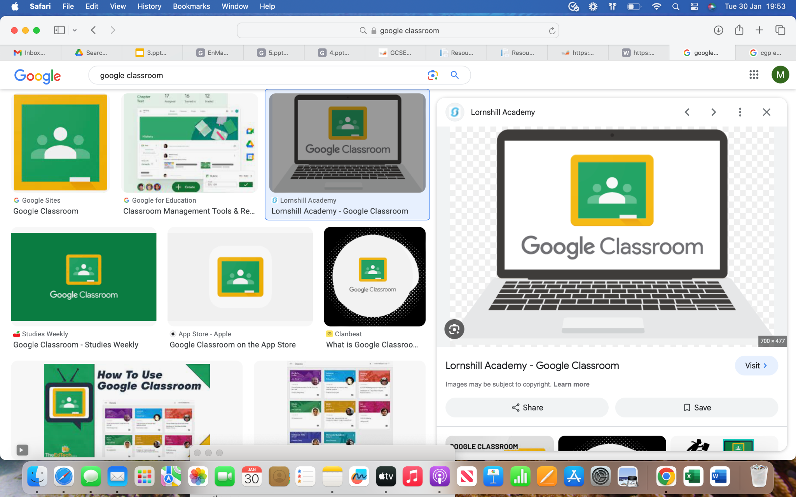
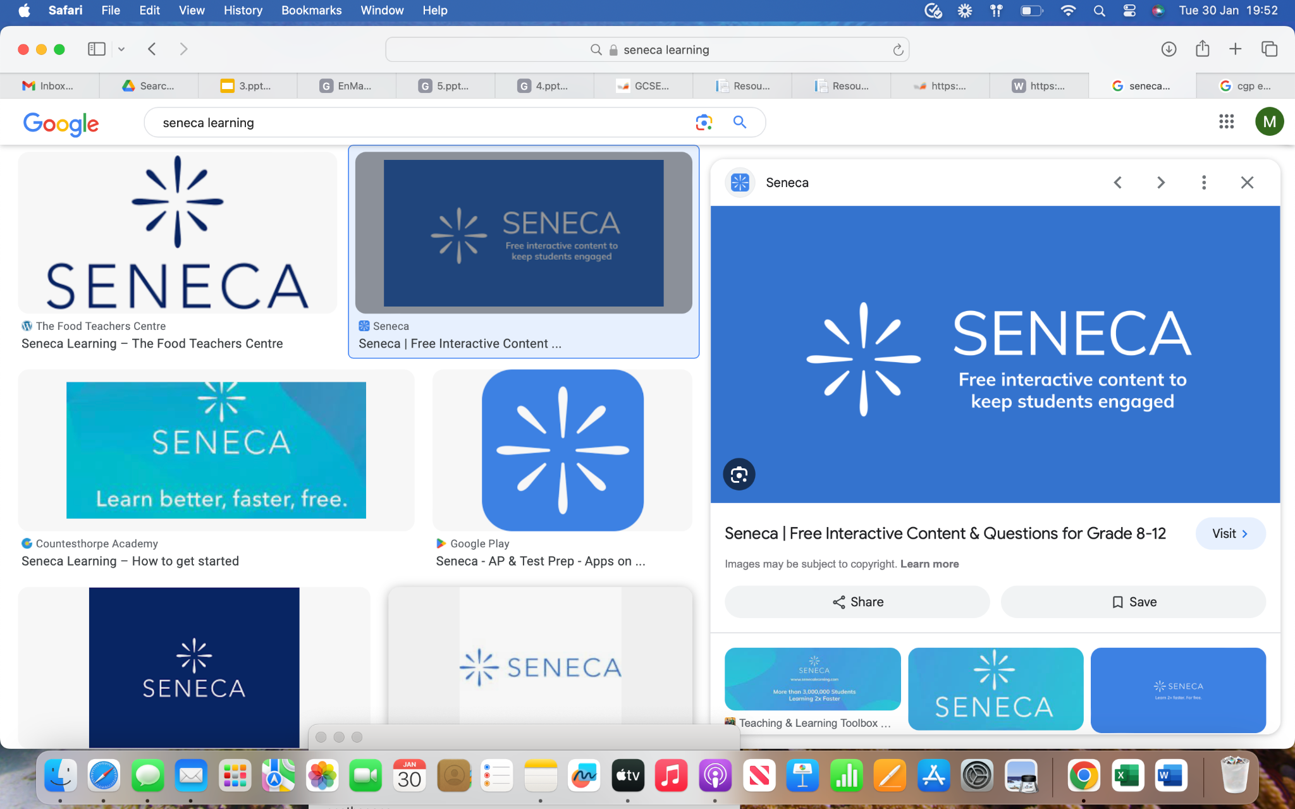
What to revise - English Literature
There are 5 topics of content that your child is required to know and apply in their exam.
They will be assessed on their knowledge of A Christmas Carol, An Inspector Calls, Macbeth, Poetry Anthology and Unseen Poetry.
Pupils have been provided with revision material for each of these topics and have clearly labelled material on Google Classroom to support this.
Each pupil has been added to Seneca Learning and Tassomai which provides revision courses and tasks for each topic.

Slide 48
What to revise - English Language
The main areas of focus for pupils when it comes to revising English Language are:
Timing- your child should be using past paper materials to work on their timing for the reading sections.
Format and structure of transactional writing - your child should be reviewing and recapping the varied structures of transactional writing they could be asked to complete.
Technical accuracy of their writing - for both their writing sections they should ensure they are working on their spelling and grammar skills.
Your child should ensure they utilising resources provided on Google Classroom, Tassomai and they can also access example past papers from their English teacher.

Slide 49
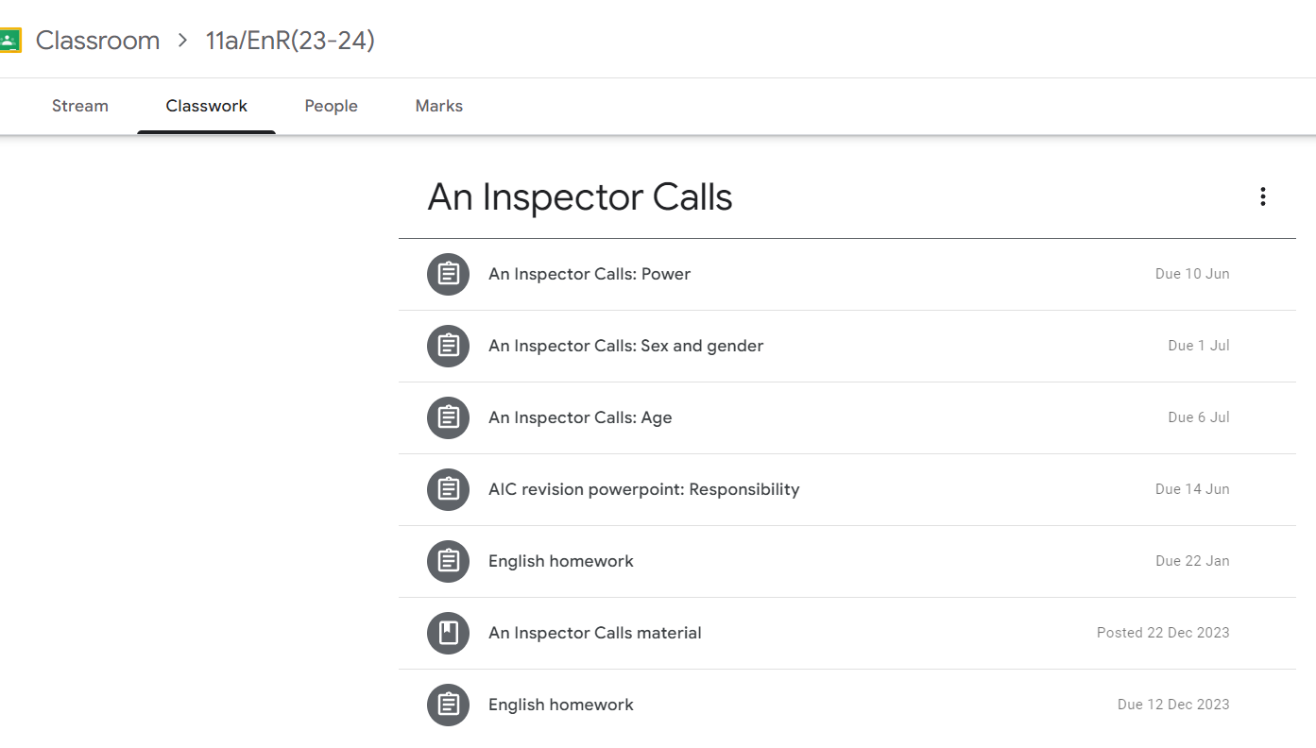
Resource and Revision Materials
Resources are regularly shared with students on the google classroom platform and organised by topic.
Youtube
Bitesize
Past papers
Teachers!!

Slide 50
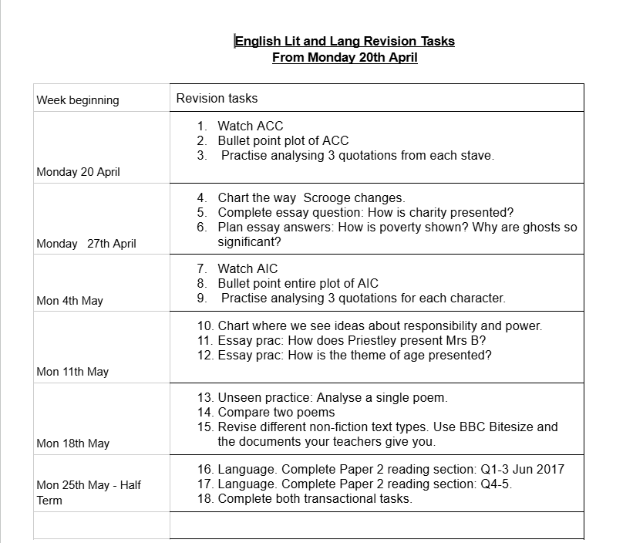
Resource Sheet
This resource sheet has been provided with detailed suggestions and focal points linked to the trial exams.

Slide 51
How parents can support their child
Ensure your child completes their Tassomai homework (100%).
The Tassomai platform provides instant feedback so your child knows how to close their gaps in their knowledge.
Ensure your child completes past papers. Hand papers back into teachers with a key to identify struggling topics.
Utilise the resource sheet (shared on google classroom)

Slide 52
Maths
Mrs K Jones

Slide 53
What exam board do we use for the maths qualification at SJP?

Slide 54
What exam board do we use for the maths qualification at SJP?
Pearson Edexcel

Slide 55
How many maths papers are issued to assess your child’s knowledge in maths?

Slide 56
How many maths papers are issued to assess your child’s knowledge in maths?
The assessment for each tier of entry consists of three externally-examined papers, all three must be from the same tier of entry. Students must complete all three papers in the same assessment series.

Slide 57
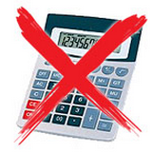
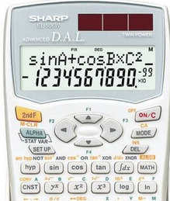
Assessment is 100% exam
Each paper carries equal weighting:
Paper 1
  Total 80 marks
  1 ½ hours long
Foundation Tier
Paper 2
  Total 80 marks
  1 ½ hours long
or
Higher
Tier
Paper 3
  Total 80 marks
  1 ½ hours long

Slide 58
June Trial Exam Dates
Summer Exam Dates:
Important dates:
3 week window
1st June 2026 - Friday 19th June 2026
2027
Paper 1: Friday, May 14 (Non-Calculator)
Paper 2: Thursday, May 27
(Calculator)
Paper 3: Monday, June 14
(Calculator)

Slide 59
Areas for development: Question Level Analysis
Any future trial examinations – an updated QLA will be produced, printed and shared with your child ensuring your child has an up to date list of those areas they struggle with.
To aid in their revision, we have highlighted topic names along with the Sparx Clip so your child knows exactly how to close the gaps in their knowledge.
Little and often is the key to success.

Slide 60
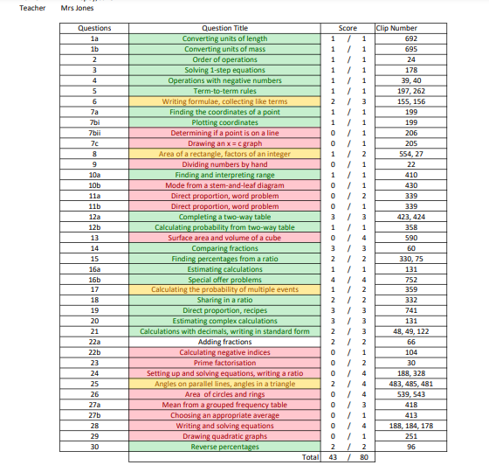
Areas for development: Question Level Analysis
A more detailed breakdown of the number of mark scored with the total amount of mark available per question.
Question number that corresponds to the recent assessment.
Topic assessed. This is also colour coded to show how well your child answered this question.
Sparx Clip number to direct your child on where they can go to close their gaps.

Slide 61
Trial exam papers and shadow papers.
Students are given back their completed papers.
It is encouraged that students use their QLA in liaison with Sparx to close their gaps in their knowledge.
It is encouraged pupils make corrections in purple pen.
It is encouraged pupils complete the shadow paper to confirm gaps in their knowledge have been closed.
Mark schemes are shared on google classroom.
Little and often is the key to success.

Slide 62
Exam Technique
Students fail exams because they do not read the question!
Students fail exams because they make silly mistakes!
To avoid/reduce missing out on crucial marks, students should be encouraged to:
Show full working out (this will reduce errors). Marks are awarded for working out.
Only choose one method and cross out any other methods.
Place your answer on the answer line.
Label diagrams - helps students to make sense of the problem.
Provide units with your answers (1 Mark!)
Make sure you answer the question: “Do they have enough?” “Which is bigger? Give reasons for your answer”
If they ask for written reasons make sure you give these!

Slide 63
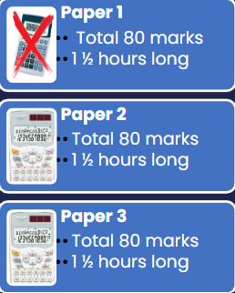
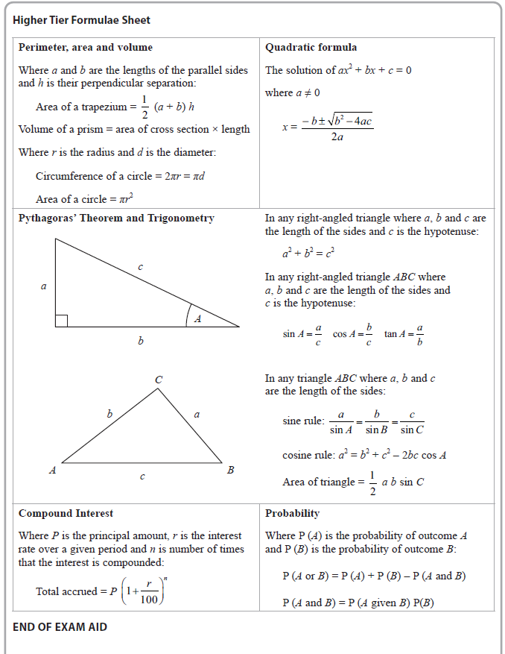
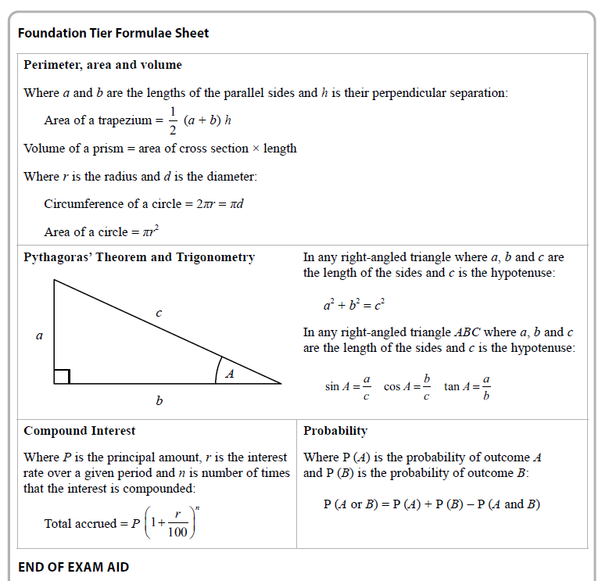
Exam Technique: Formula Sheet

Slide 64
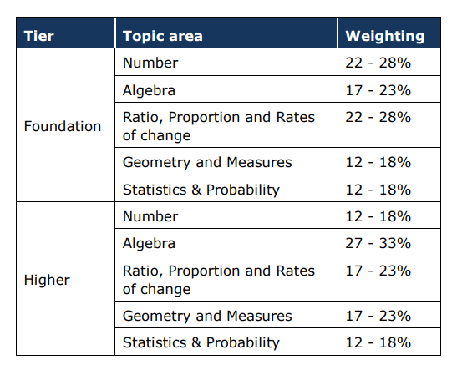
What to revise
There are 6 topic areas of knowledge and skills that you are required to know and apply in your exam.
Sub topics in each topic area do not always appear on the same paper and also sometimes come up less often so it is important that you are confident in all these strands.
A revision list (created by Sparx but mirrors these overarching themes has been shared with your child on google classroom).

Slide 65
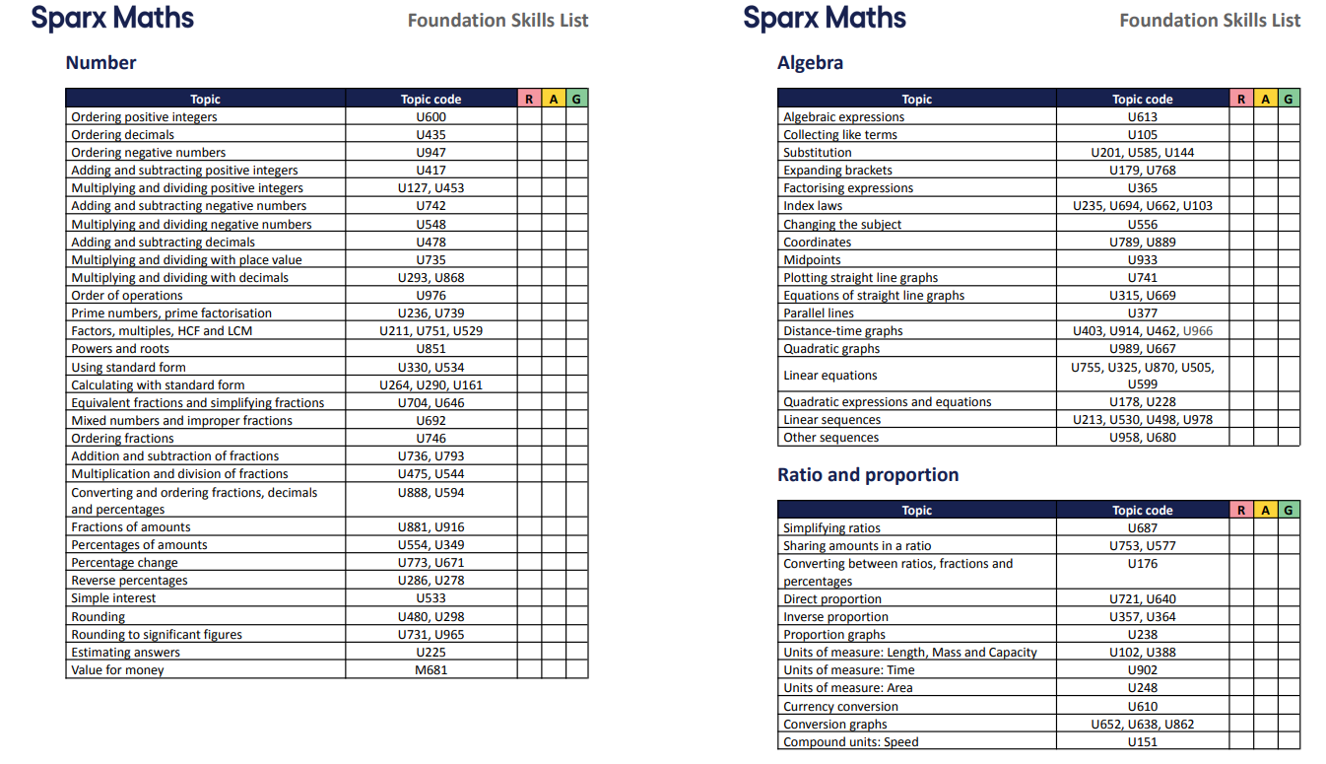
What to revise
There are over 100 topics lists here.
Hopefully you can also see that there are often multiple clip number for each too!
Little and often is the key to success.

Slide 66
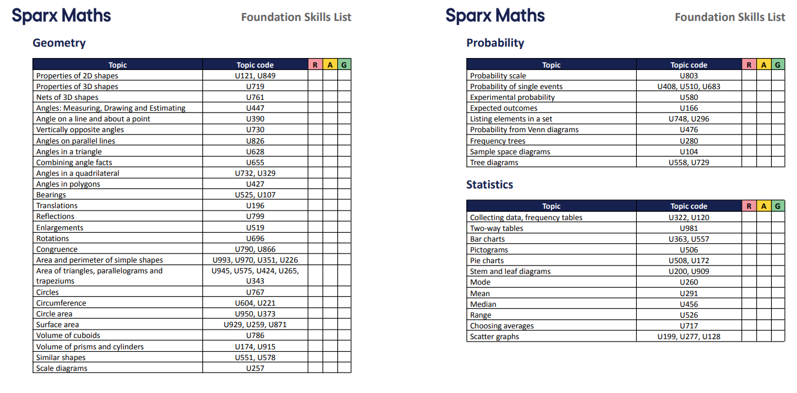
What to revise

Slide 67
How parents can support their child
Maths Club Wednesday after school in Ma5 3:10 - 4:10pm.
Ensure your child completes their Sparx homework fortnightly (100%). This is set Tuesday and due in for Tuesday. The Sparx platform provides instant feedback and support videos so your child knows how to close their gaps in their knowledge.
Ensure your child completes a past paper fortnightly. Students should use the QR code on the front of the paper to self assess. Hand papers back into teachers with a key to identify struggling topics.
Utilise the resource sheet (shared on google classroom)
Have the necessary equipment required (i.e. a calculator)
Little and often is the key to success.

Slide 68
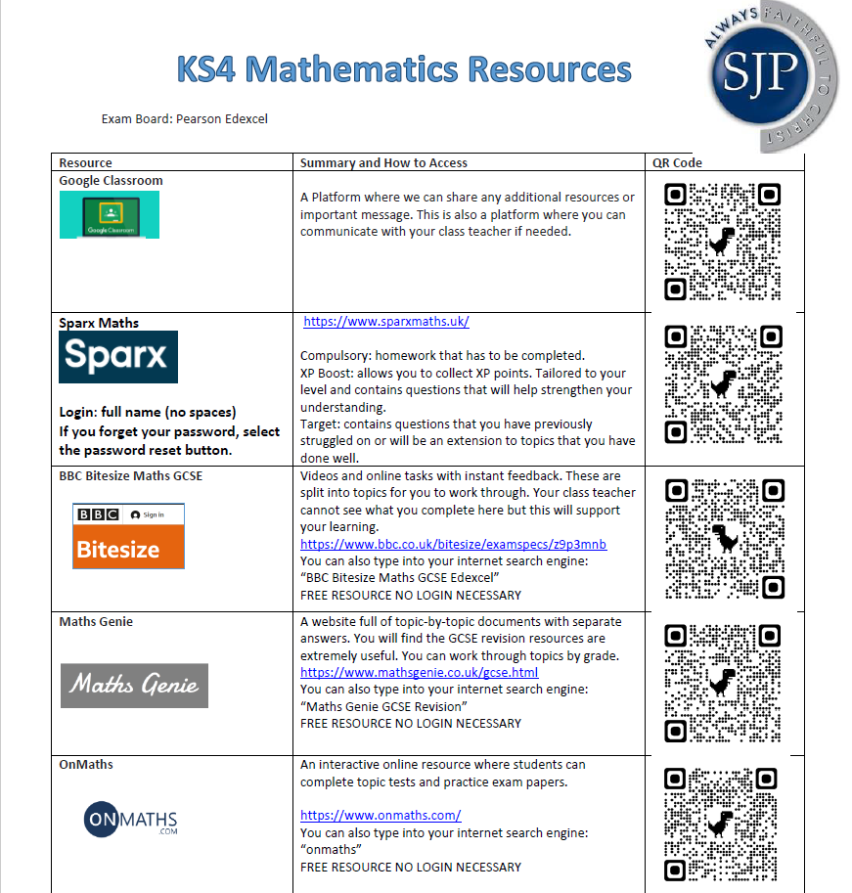
Resource Sheet
This resource sheet is regularly shared with students on the google classroom platform.

Slide 69



Live exploration of resources

Slide 70

Paul Halmos

Slide 71
RE
Mrs Harvey
Head of RE

Slide 72
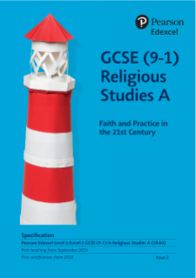
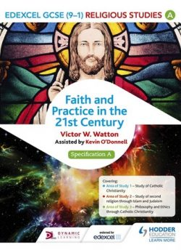
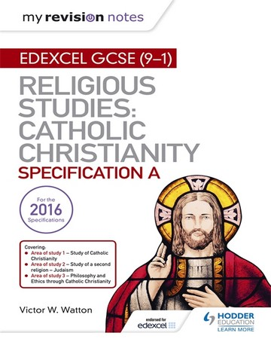
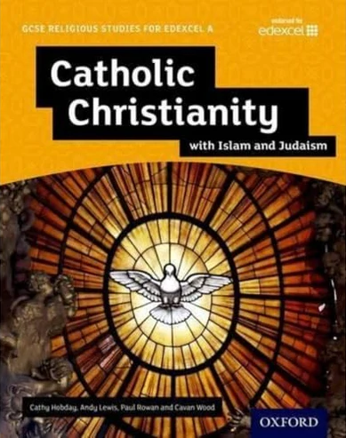
What exam board do we use for the
Religious Education at SJP?
Pearson Edexcel A (Not B which is the short course)

Slide 73
How is the course structured?
Paper 1
Catholic Christianity:
Beliefs and teachings
Practices
Sources of Wisdom and Authority
Forms of Expression and Ways of Life
50% exam
1hr 45mins
Paper 2
Judaism:
Beliefs and Teachings
Practices
25%
50 mins
Paper 3
Catholic Christianity - Philosophy and Ethics
Arguments for the Existence of God
Religious Teachings on Relationships and Families in the 21st Century
25% 50 mins
All three exams are completed at the end of Year 11

Slide 74
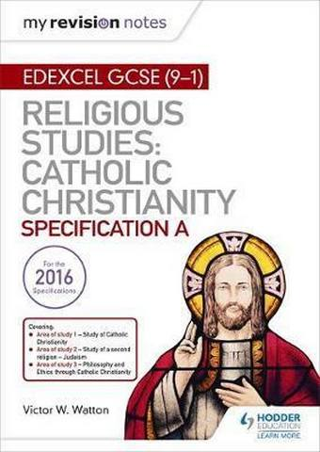
Paper 1 - Catholic Christianity - 1hr 45mins - 50%
Beliefs & Teachings
Trinity
Biblical understandings of God as Trinity
Creation
The nature of humanity
The Incarnation
The events of the Paschal Mystery
The nature of salvation and grace Eschatology
Practices
The Sacramental Nature of Reality
Catholic liturgical worship
The Catholic funeral rite
Prayer
Forms of popular piety
Pilgrimage
Catholic Social Teaching
Catholic mission and evangelism
Sources of Wisdom & Authority
The Bible
Interpretation of the Bible
Scripture, tradition and the magisterium
The Second Vatican Council
The Church as the Body of Christ and the People of God
The four marks of the Church
Mary as a model of the Church
Sources of personal and ethical decision-making
Forms of Expression and Ways of Life
The architecture, design and decoration of the Catholic Church
The different internal features of a Catholic Church
The meaning and significance of Sacred Objects within Catholicism
The meaning and significance of paintings, frescoes and drawings
The meaning and significance of sculptures and statues
The purpose and use of symbolism and imagery in religious art
The meaning and significance of drama, mystery plays and passion plays
The nature and use of traditional and contemporary styles of music in worship
Paper 2 - Judaism - 50 mins -25%
Beliefs & Teachings
The nature of the Almighty
Shekinah
Messiah
The covenant at Sinai
The Covenant with Abraham
Sanctity of life
Moral principles and the Mitzvot
Jewish beliefs about life after death
Practices
Public acts of worship
The Tenakh and the Talmud
Prayer
Shema and Amidah
Rituals and ceremonies
Shabbat
Festivals
Features of the synagogue
Paper 3 - Philosophy and Ethics 50mins - 25%
Arguments for the existence of God
Revelation as proof of the existence of God
Visions
Miracles as proof of the existence of God
Catholic attitudes to religious experience
The design argument
The cosmological argument
The problem of evil and suffering
Solutions to the problem of evil and suffering
Religious Teachings on relationships and families in the twenty-first century
Marriage
Sexual relationships
Families
Support for the family in the local parish
Contraception
Divorce and remarriage
Equality of men and women in the family
Gender prejudice and discrimination
Edexcel A GCSE - RE Revision List
Notes:
What is icked is what they have done and will be on the trial exam

Slide 75
Paper 1 - Catholic Christianity - 1hr 45mins - 50%
Beliefs & Teachings
Trinity
Biblical understandings of God as Trinity
Creation
The nature of humanity
The Incarnation
The events of the Paschal Mystery
The nature of salvation and grace Eschatology
Practices
The Sacramental Nature of Reality
Catholic liturgical worship
The Catholic funeral rite
Prayer
Forms of popular piety
Pilgrimage
Catholic Social Teaching
Catholic mission and evangelism
Sources of Wisdom & Authority
The Bible
Interpretation of the Bible
Scripture, tradition and the magisterium
The Second Vatican Council
The Church as the Body of Christ and the People of God
The four marks of the Church
Mary as a model of the Church
Sources of personal and ethical decision-making
Forms of Expression and Ways of Life
The architecture, design and decoration of the Catholic Church
The different internal features of a Catholic Church
The meaning and significance of Sacred Objects within Catholicism
The meaning and significance of paintings, frescoes and drawings
The meaning and significance of sculptures and statues
The purpose and use of symbolism and imagery in religious art
The meaning and significance of drama, mystery plays and passion plays
The nature and use of traditional and contemporary styles of music in worship
Year 10 Trial Exam
ONLY doing the Catholic Christianity Paper
1hr 45mins

Slide 76
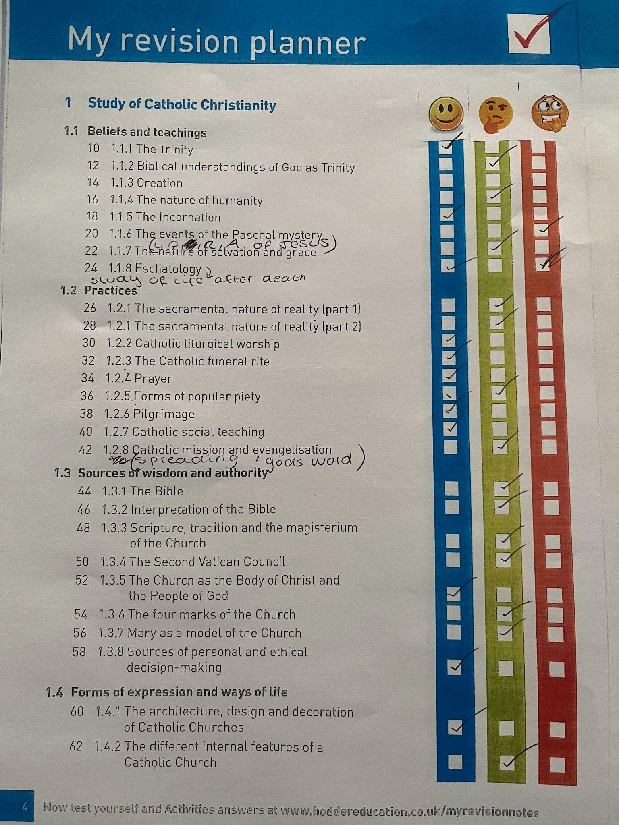
Checklist against each topic

Slide 77
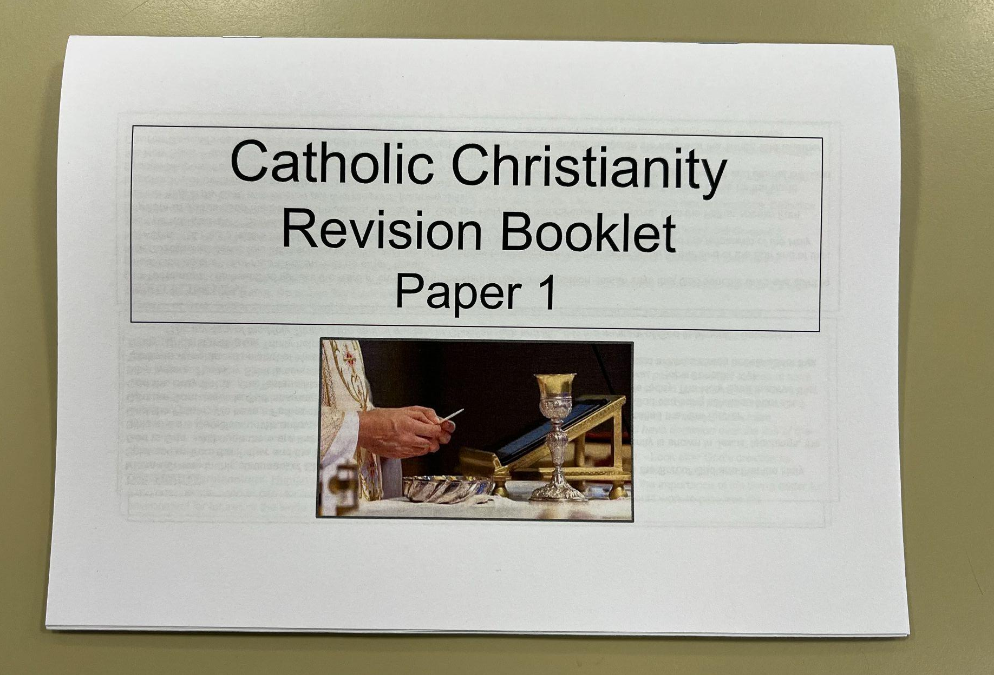
Catholic Christianity Revision Booklet

Slide 78
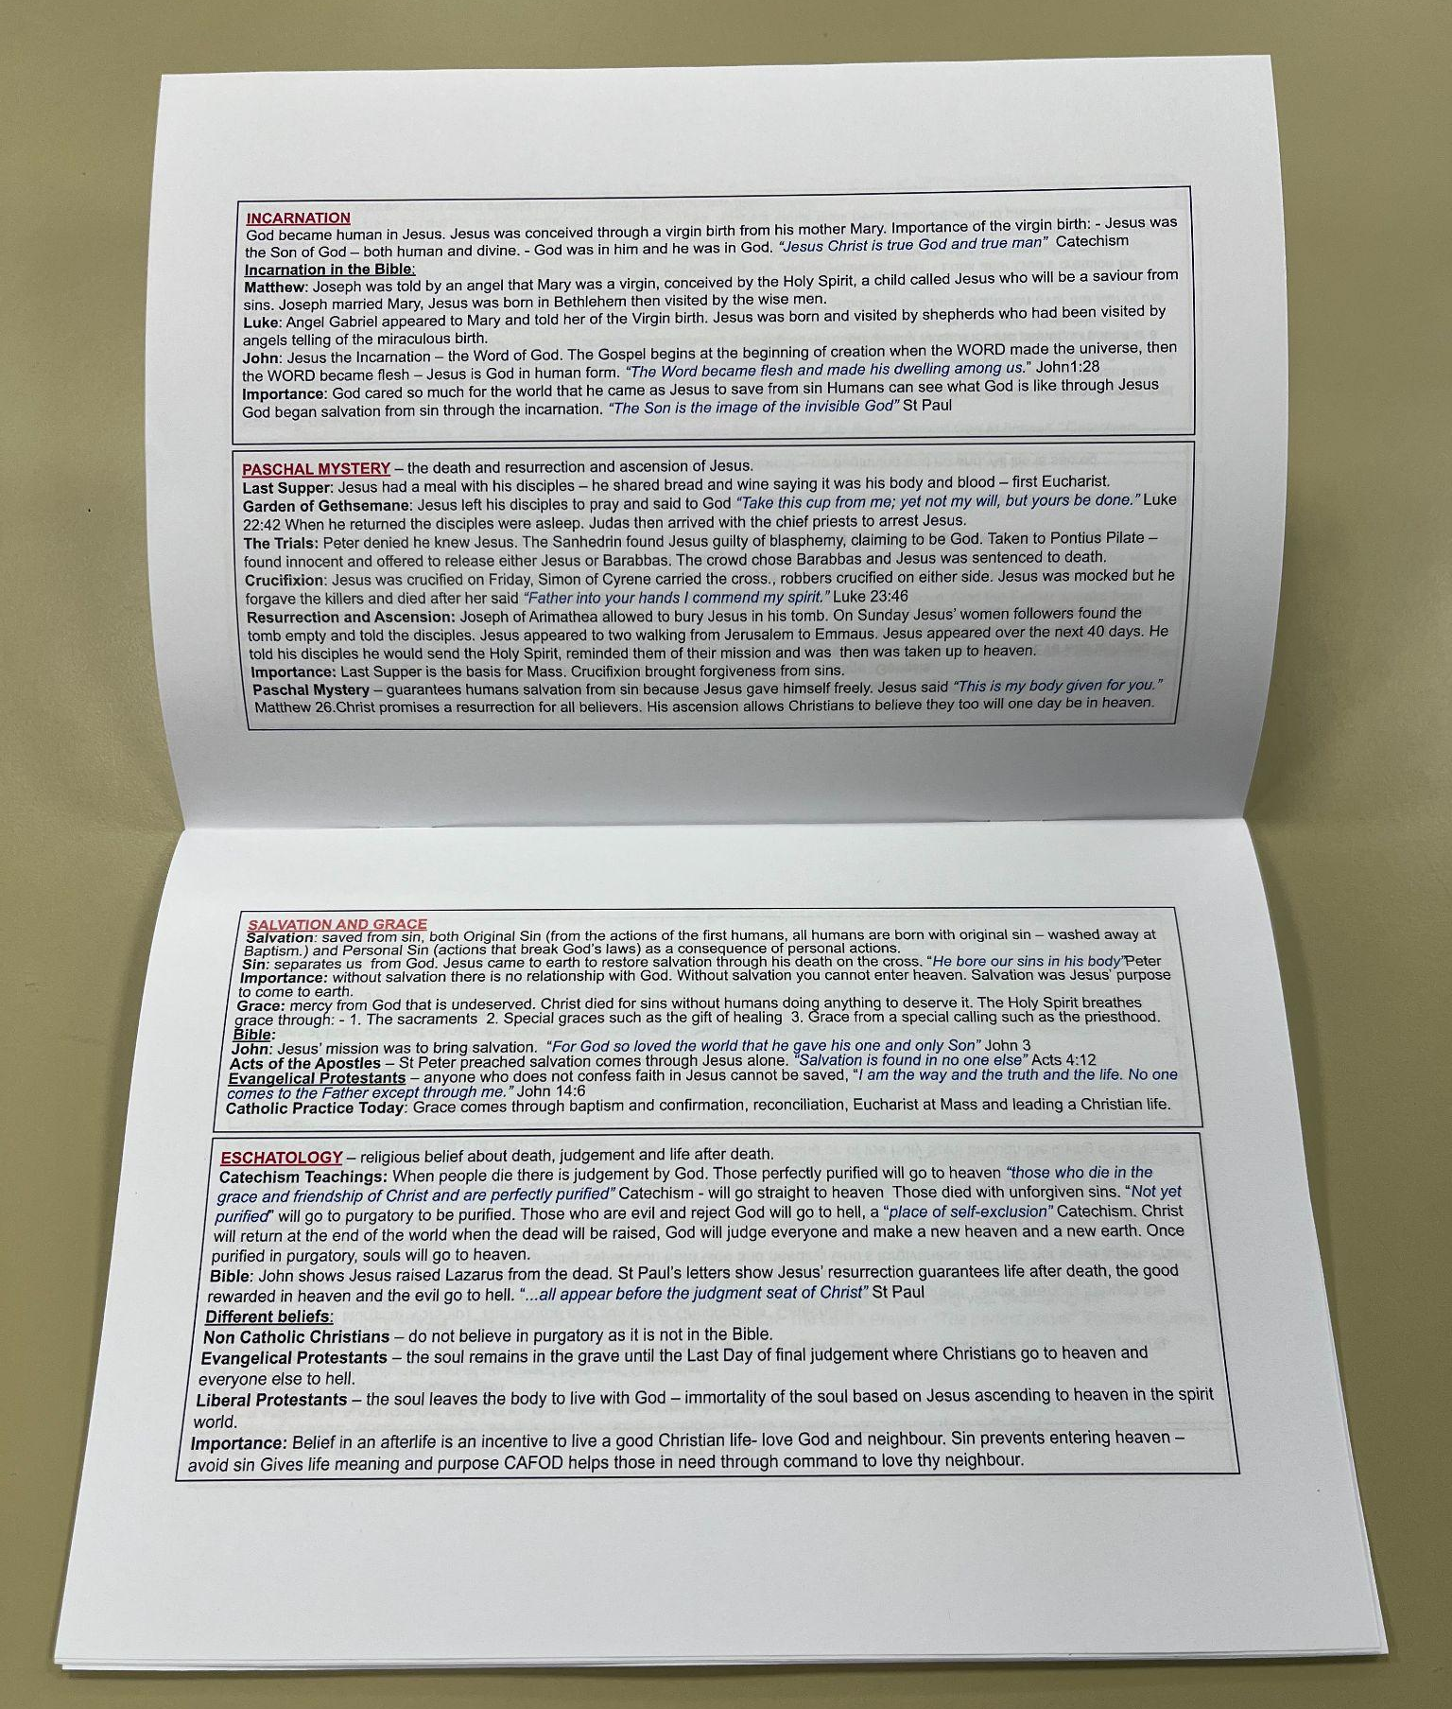
Each of the 4 sections of the paper are broken down into key revision notes;
Beliefs and Teachings
Practices
Sources of Wisdom and Authority
Forms of Expression and Ways of Life

Slide 79
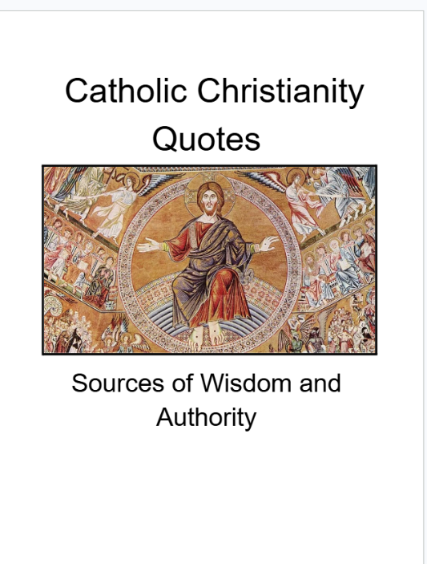
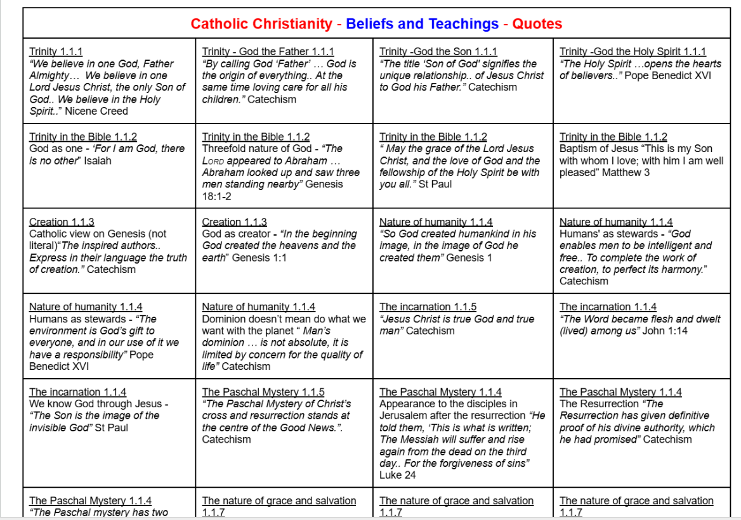
Key Quotes

Slide 80

Exam Question Booklets

Slide 81

The booklet covers every exam question that has been asked
2018 - 2025

Slide 82

Practice questions and then use the mark scheme on the exam website to mark the response

Slide 83




4 x Revision PPTs shared on GC

Slide 84




Four Revision Explainer Videos

Slide 85

RE SJP GCSE Website

Slide 86

SENECA Platform
The platform is designed to be low-stress and highly effective:
Bitesize Revision: Topics are broken down into short, manageable chunks that fit easily into a busy home schedule.
Adaptive Learning: The smart algorithm identifies your child's strengths and weaknesses. If they struggle with a specific concept, the system will automatically re-present that information in different formats until it is fully understood.

